Slide 1
Taking input from the user
Three ways to accept the values dynamically
From Cmd prompt
From scanner
From BufferedReader
From properties file
Cmd prompt
Using main method passing the input values as array of String objects (String args[])
Convert the received String objects using wrapper classes as follows:
Public static XXX parseXXX(String).
Ex: To convert String to integer
Int a =Integer.parseInt(args[0]);
From keyboard
Use Scanner class from java.util.scanner package
Scanner s = new Scanner ( System.in );
int firstNumber = s.nextInt();
Method | Description
nextByte() | Accept a byte
nextShort() | Accept a short
nextInt() | Accept an int
nextLong() | Accept a long
next() | Accept a single word
nextLine() | Accept a line of String
nextBoolean() | Accept a boolean
nextFloat() | Accept a float
nextDouble() | Accept a double

Slide 2
Scanner class
Scanner is the best way to read input from key board
Scanner class breaks the input into tokens using a delimiter which is whitespace by default.

Slide 3
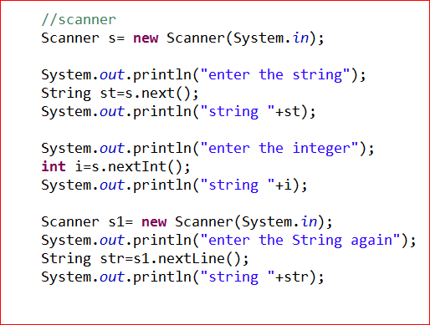
Reading Inputs From Keyboard

Slide 4
Reading Inputs From BufferedReader
Create a BufferedReader object as follows:
BufferedReader br = new BufferedReader(new InputStreamReader(System.in));
To read a String String str = br.readLine();
To read a char char ch = (char) br.read(); or char ch = br.readLine().charAt(0);
To read a Integer
int i = Integer.parseInt(str); or int i = Integer.parseInt(br.readLine());
You can read input values at a time using readLine() seperated with delimiter like ‘,’ then use
StringTokenizer st = new StringTokenizer(str,”,”);
Collect individual tokens from st using nextToken()
String token = st.nextToken();

Slide 5

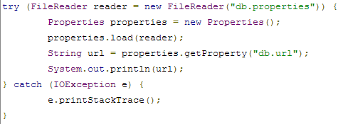
Taking input from the user
From properties file
Create a file name db.properties and data as key=value format as follows:
Read the properties file using FileReader and properties class in main method as follows:

Slide 6
Arrays
fixed-size sequential collection of similar elements
It is static DS, since size of array must be specified at declaration time
Creation, initialization and accessing array
dataType[] arrayRefVar; // preferred way. or
dataType arrayRefVar[]; // works but not preferred way.
Initialization:
dataType[] arrayRefVar = new dataType[arraySize]; or
dataType[] arrayRefVar = {value0, value1, ..., valuek};
int [] numberArray={1,2,3};

Slide 7
Multi- dimensional array :
int [][] numberArray = {
{10, 20, 30, 40, 50},{60,70,80}
};
System.out.println("size"+ numberArray.length);
System.out.println("size"+ numberArray [0].length);
Each element in array is accessed using index value.
In java, since array is a object, manipulation can be done using some predefined methods

Slide 8
Methods
copyOfRange():copies array elements, but destination array is returned by the method.
copyOfRange(Object src, int srcPos,int destPos);
copyOf (Object src, length)
binarySearch(Object [] src,object key);
equals(Object[] a1, object[] a2);
fill(Object[] a1,int val);
sort(Object[]);
Ex: Arrays.sort(arr);
Arrays.binarySearch(arr, 2);

Slide 9
System class method for arrays
System.arraycopy(): efficiently copy data from one array into another
public static void arraycopy(Object src, int srcPos, Object dest, int destPos, int length)
srcPos: element position in the source array from which elements are to be copied
destPos: element position in the destination array to where elements to be copied
Length: no of elements to be copied
Ex: System.arraycopy(arr1, 0, arr2, 1, 3);

Slide 10
Object Oriented Programming (OOPs)
Object Oriented Programming is a paradigm that provides many concepts such as inheritance, data binding, polymorphism etc.
Simula is considered as the first object-oriented programming language. The programming paradigm where everything is represented as an object, is known as truly object-oriented programming language.
Smalltalk is considered as the first truly object-oriented programming language
Object means a real word entity such as pen, chair, table etc. Object-Oriented Programming is a methodology or paradigm to design a program using classes and objects. It simplifies the software development and maintenance by providing some concepts:
Object
Class
Inheritance
Polymorphism
Abstraction
Encapsulation

Slide 11
Object Oriented Programming (OOPs)
Object
Any entity that has state and behavior is known as an object. For example: chair, pen, table, keyboard, bike etc. It can be physical and logical.
Class
Collection of objects is called class. It is a logical entity.
Inheritance
When one object acquires all the properties and behaviours of parent object i.e. known as inheritance. It provides code reusability. It is used to achieve runtime polymorphism.
Polymorphism
When one task is performed by different ways i.e. known as polymorphism. For example: to convense the customer differently, to draw something e.g. shape or rectangle etc.
In java, we use method overloading and method overriding to achieve polymorphism.
Another example can be to speak something e.g. cat speaks meaw, dog barks woof etc.
Abstraction
Hiding internal details and showing functionality is known as abstraction. For example: phone call, we don't know the internal processing.
In java, we use abstract class and interface to achieve abstraction.

Slide 12
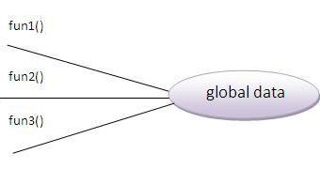
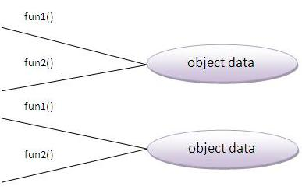
Object Oriented Programming (OOPs)
Encapsulation
Binding (or wrapping) code and data together into a single unit is known as encapsulation. For example: capsule, it is wrapped with different medicines.
A java class is the example of encapsulation. Java bean is the fully encapsulated class because all the data members are private here.
Advantage of OOPs over Procedure-oriented programming language
1)OOPs makes development and maintenance easier where as in Procedure-oriented programming language it is not easy to manage if code grows as project size grows.
2)OOPs provides data hiding whereas in Procedure-oriented prgramming language a global data can be accessed from anywhere.
3)OOPs provides ability to simulate real-world event much more effectively. We can provide the solution of real word problem if we are using the Object-Oriented Programming language.

Slide 13
Immutable classes are the one which can not be modified once it gets created and String is primary example of immutable.
Immutable classes offer several benefits one of them is that they are effectively read-only and can be safely shared in between multiple threads without any synchronization overhead.
Final and abstract are two opposite keyword and a final class can not be abstract in java.
Final methods are bonded during compile time also called static binding.
Final variables which is not initialized during declaration are called blank final variable and must be initialized on all constructor either explicitly or by calling this().
Failure to do so compiler will complain as "final variable (name) might not be initialized".

Slide 14
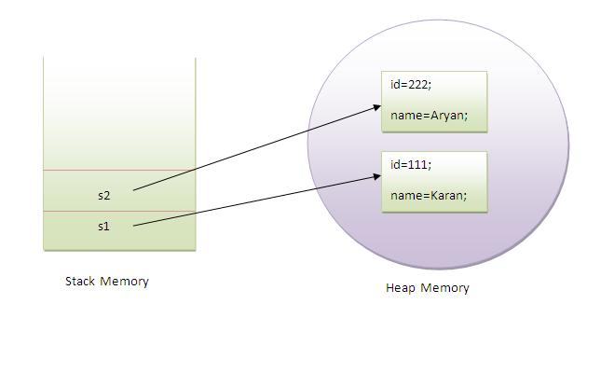
Classes in java
An entity that has state and behaviour is known as an object. An object is an instance of a class.
A class is a group of objects that has common properties. It is a template or blueprint from which objects are created
A class in java can contain:
data member
method
constructor
block
class and interface
Syntax to declare a class:
class <class_name>{
data member;
method definition;
}
Student
studId studName marksSub1 marksSub2 marksSub3
createStudent() displayInfo() totalMarks() averageMarks() getGrade()
Class name
Properties or attributes or data members
Methods or behaviour
Note: use method names as get and set for read input value and display information.

Slide 15
Classes and objects
class MyClass extends MySuperClass implements YourInterface
{
// field, constructor, and
// method declarations
}
In general, class declarations can include these components, in order:
Modifiers such as public, private, and a number of others that you will encounter later.
The class name, with the initial letter capitalized by convention.
The name of the class's parent (superclass), if any, preceded by the keyword extends. A class can only extend (subclass) one parent.
A comma-separated list of interfaces implemented by the class, if any, preceded by the keyword implements. A class can implement more than one interface.
The class body, surrounded by braces, {}.
Declaring Member Variables
There are several kinds of variables:
Member variables in a class—these are called fields.
Variables in a method or block of code—these are called local variables.
Variables in method declarations—these are called parameters.

Slide 16
Classes and objects
Methods
A typical method declaration:
public double calculateAnswer(double wingSpan, int numberOfEngines, double length, double grossTons)
{
//do the calculation here
}
A method declarations have six components, in order:
Modifiers—such as public, private, and others you will learn about later.
The return type—the data type or void if the method does not return a value.
The method name—the rules for field names apply to method names as well, but the convention is a little different.
The parameter list in parenthesis
An exception list
The method body, enclosed between braces

Slide 17
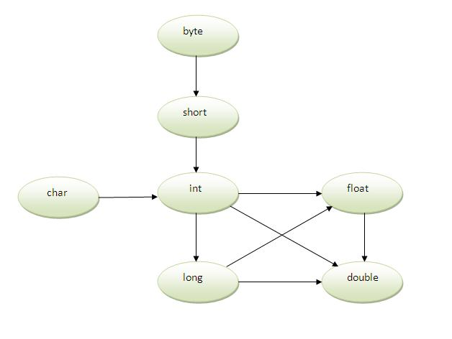
Method Overloading in Java
A method is said to be overloaded if and only if method name is same and but signature is different
Different ways to overload the method
By changing number of arguments
By changing the data type
By changing the order
Method overloading = method heading is same + method body is different
Overload the methods in subclasses
Method Overloading and TypePromotion
public class DataArtist
{ ...
public void draw(String s) { ... }
public void draw(int i) { ... }
public void draw(double f) { ... }
public void draw(int i, double f) { ... }
}
Demo for overloading method sum

Slide 18
Method Overloading in Java
class OverloadingCalculation1{
void sum(int a,long b){System.out.println(a+b);}
void sum(int a,int b,int c){System.out.println(a+b+c);}
public static void main(String args[]){
OverloadingCalculation1 obj=new OverloadingCalculation1();
obj.sum(20,20);//now second int literal will be promoted to long
obj.sum(20,20,20);
}
}
class OverloadingCalculation3{
void sum(int a,long b){System.out.println("a method invoked");}
void sum(long a,int b){System.out.println("b method invoked");}
public static void main(String args[]){
OverloadingCalculation3 obj=new OverloadingCalculation3();
obj.sum(20,20); //now ambiguity
}
}

Slide 19
Classes and objects
There are many ways to create an object in java. They are:
By new keyword
By newInstance() method
By clone() method
By factory method etc.
Relationships between Classes
Common relation ships are
Dependence(“use-a”) – class A depends on another class B
aggregation(“has-a”) – class A contains objects of class B
Inheritance(“is-a”) – class A extends class B , class A inherits from class B but has more capabilities.

Slide 20
Object creation using newInstance() method
public class NewInstanceObjectCreate{
public String toString(){
return "In toString() method of NewInstanceObjectCreate";
}
public static void main(String args[]){
try{
Class c = Class.forName("NewInstanceObjectCreate");
Object o=c.newInstance();
System.out.println(o.toString());
}catch(Exception e){}
}
}

Slide 21
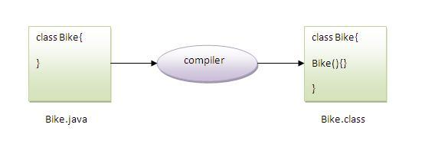
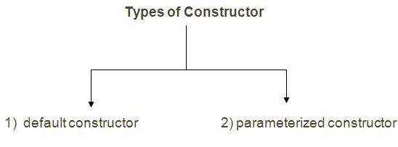
CONSTRUCTORS
Constructor is a special type of method that is used to initialize the object.
If there is no constructor in a class, compiler automatically creates a default constructor.
Rules: Constructor name must be same as its class name
Constructor must have no explicit return type
Default Constructor – no parameters
Syntax: <class_name>(){}
Parameterized constructors
Syntax: <class_name>(parameters list){}
demo

Slide 22
Passing Primitive Data Type Arguments
Primitive arguments, such as an int or a double, are passed into methods by value.
Passing Reference Data Type Arguments
Reference data type parameters, such as objects, are also passed into methods by value.
public void moveCircle(Circle circle, int deltaX, int deltaY)
{
// code to move origin of circle to x+deltaX, y+deltaY
circle.setX(circle.getX() + deltaX); circle.setY(circle.getY() + deltaY);
// code to assign a new reference to circle
circle = new Circle(0, 0);
}

Slide 23
Class Methods
Method Arguments :
example:
int calcLoanPayment(int amount, int numberOfMonths, String state){
// Your code goes here
}
When you call a function, Java run time tries to find the function that has been declared with the specified signature. For example, if you try to call the preceding function like this:
calcLoanPayment(20000, 60);
Java compiler will give you an error complaining that no calcLoanPayment() function has been found that expects just two arguments.
Notes:
23

Slide 24
Java is pass-by-value that means pass-by-copy
int x = 7 ;
void go (int z) { ….. }
foo.go(x)
void go(int z)
{
z = 0;
}
In Case of Objects :
Tax t2 = t;
The code line above will not create another
copy of the Tax object in memory, but will copy its address to the variable t2 . Now we still have a single instance of the Tax object, but two reference variables — t and t2 — are pointing at it.
Until both of these variables will go out of scope (explained in the next section), the object Tax will not be removed from memory.
Notes:
24

Slide 25
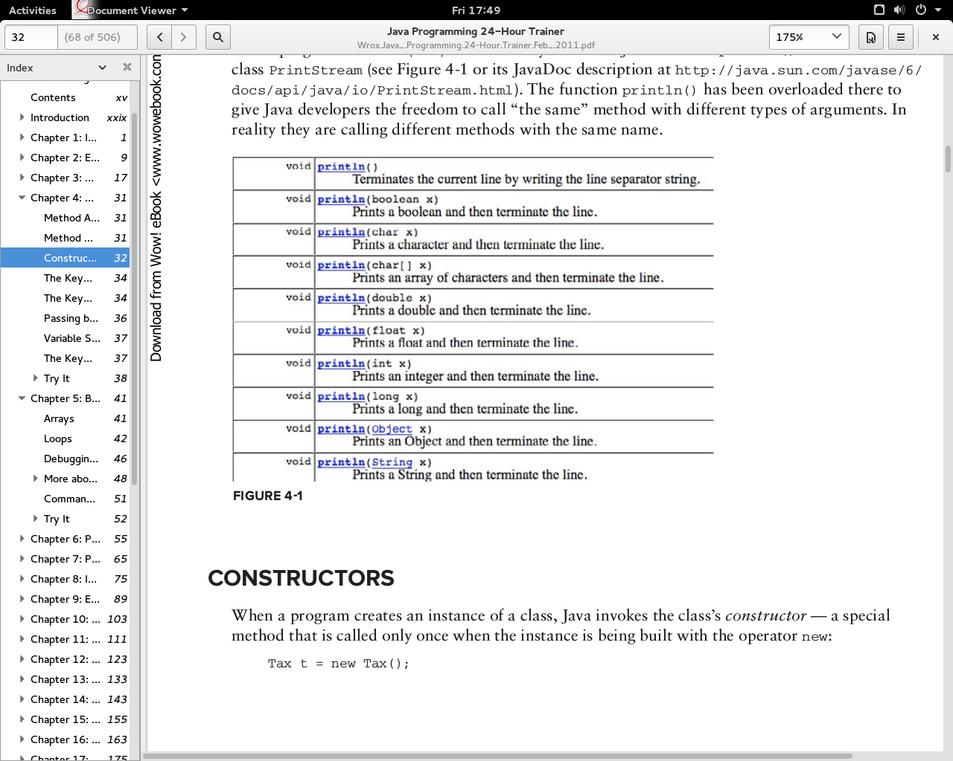
Method Overloading
If you want to allow the calling of a function with different numbers of arguments, you need to create multiple versions of this function.
Notes:
25

Slide 26
Method Overloading
Method overloading
– Allows a method with the same name but different parameters, to have different implementations and return values of different types
– Can be used when the same operation has different implementations.
Always remember that overloaded methods have the following properties:
– The same method name
– Different parameters or different number of parameters
– Return types can be different or the same

Slide 27
Example : Method Overloading
public void print( String temp ){
system.out.println("name:" + name);
system.out.println("address:" + address);
system.out.println("age:" + age);
}
public void print(double egrade, double mgrade, double sgrade)
system.out.println("name:" + name);
system.out.println("math grade:" + mgrade);
system.out.println("english grade:" + egrade);
system.out.println("science grade:" + sgrade);
}

Slide 28
Example
public static void main( String[] args )
{
StudentRecord annarecord = new StudentRecord();
annarecord.setname("anna");
annarecord.setaddress("philippines");
annarecord.setage(15);
annarecord.setmathgrade(80);
annarecord.setenglishgrade(95.5);
annarecord.setsciencegrade(100);
//overloaded methods
annarecord.print( annarecord.getname() );
annarecord.print( annarecord.getenglishgrade(), annarecord.getmathgrade(), annarecord.getsciencegrade() );
}

Slide 29
Output
we will have the output for the first call to print,
name:anna
address:philippines
age:15
● we will have the output for the second call to print,
name:anna
math grade:80.0
english grade:95.5
science grade:100.0

Slide 30
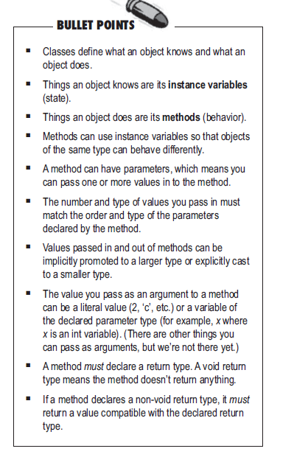
Remember: Java care about the type.
What happens if the argument you want to pass is an objects instead of primitive?
Can a method declare multiple return values? Or is there any way to return more than one value.
Do I have to return the exact type I declared?
Notes:
30

Slide 31
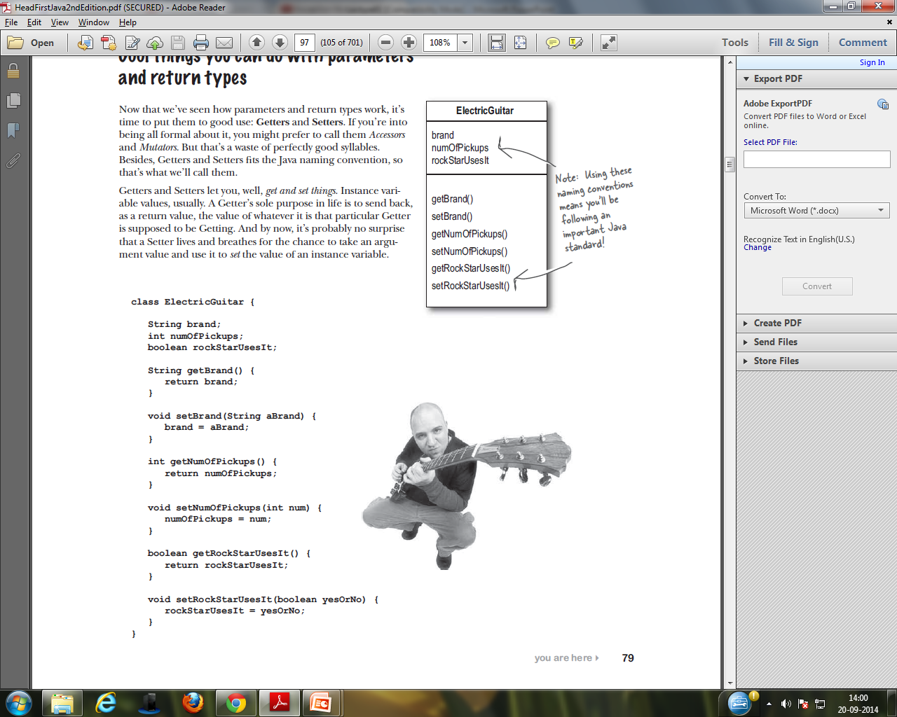
Notes:
31

Slide 32
Static block
Static block is a bloc of statements declared as ‘static’.
These static blocks will be called when JVM loads the class into memory. Incase a class has multiple static blocks across the class, then JVM combines all these blocks as a single block of code and executes it.
public class myclass{ static{ //some statements here
System.out.println(“ static method called”); } //some variables declared here //some functions defined here
public static void main(String [] args) {
System.out.println(“ Main .method called ”);
} }

Slide 33
Accessors & Mutators (getters & Setters)

Slide 34
accessor (getter) methods
– used to read values from our class variables (instance/static).
– usually written as:
get<nameofinstancevariable>
– it also returns a value.

Slide 35
Example 1: Accessor (Getter) Method
public class StudentRecord {
private string name;
:
public string getName(){
return name;
}
}
– where,
public - means that the method can be called from objects outside the class
string - is the return type of the method. this means that the method should return a value of type string
getName - the name of the method
() - this means that our method does not have any parameters

Slide 36
Example 2: Accessor (Getter) Method
public class StudentRecord {
private string name;
// some code
// an example in which the business logic is
// used to return a value on an accessor method
public double getAverage(){
double result = 0;
result=(mathgrade+englishgrade+sciencegrade)/3;
return result;
}
}

Slide 37
Mutator (Setter) Method
mutator methods
– used to write or change values of our class variables (instance/static).
– usually written as:
set<nameofinstancevariable>

Slide 38
Example : Mutator (Setter) Method
public class StudentRecord {
private string name;
:
public void setName( String temp ){
name = temp;
}
}
– where,
● public - means that the method can be called from objects outside the class
● void - means that the method does not return any value
● setname - the name of the method
● (string temp) - parameter that will be used inside our method

